Slide 1
Surface reconstruction from models for subtractive manufacturing simulation
Bernhard Manfred Gruber

Slide 2
Overview
Subtractive manufacturing
Previous work
Problem statement
Approaches
Implementations
Results
Conclusion

Slide 3
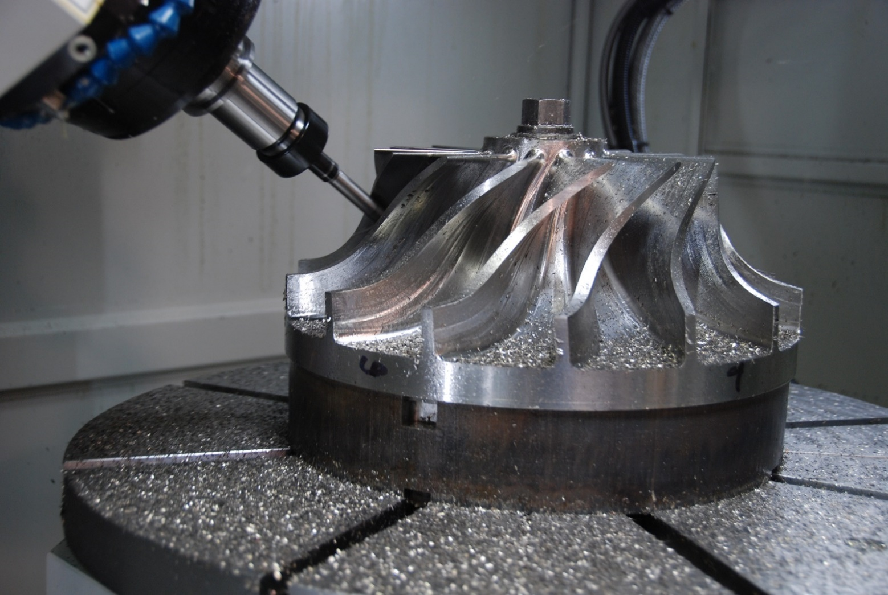
Subtractive manufacturing
http://www.hurco.com/IN/why-hurco/success-stories/blog/PublishingImages/nuconvmx42sr%20cutting.JPG

Slide 4
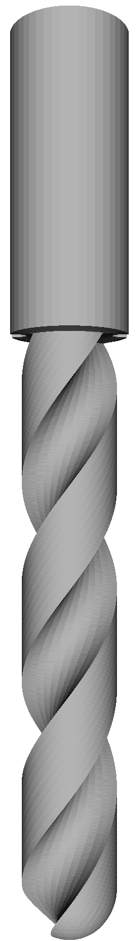
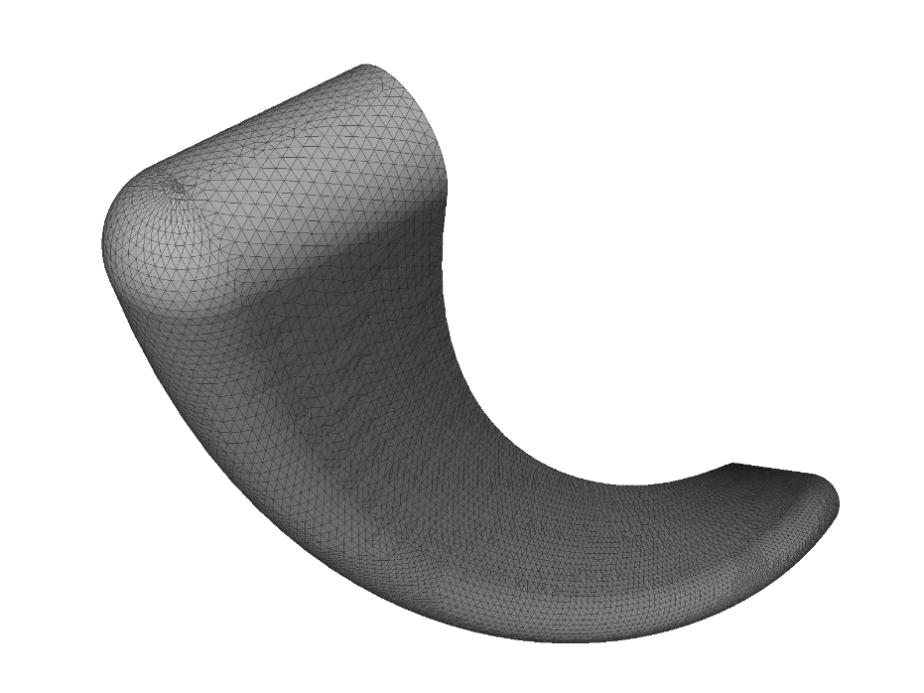
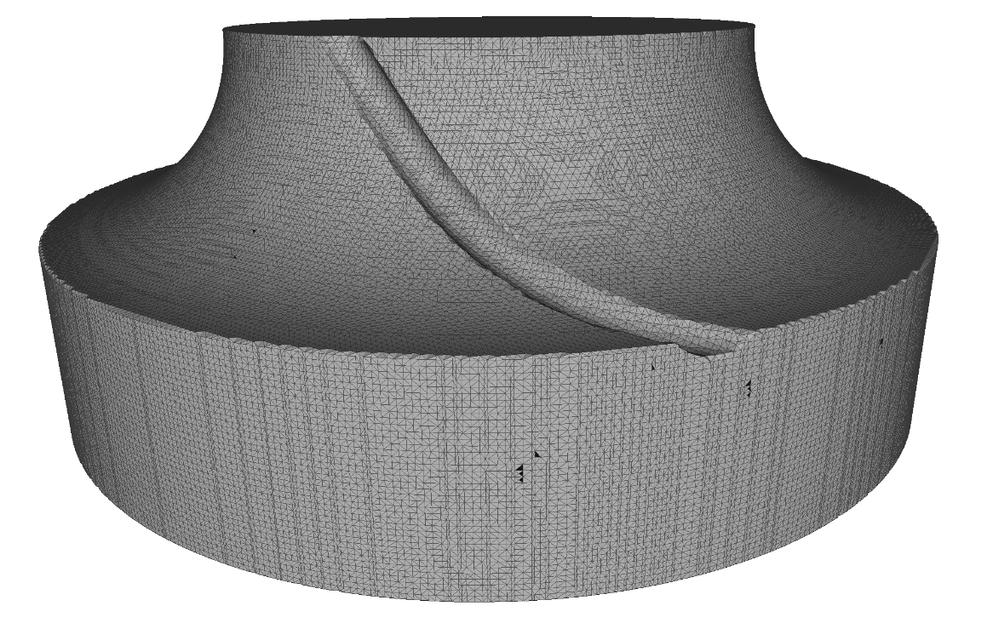
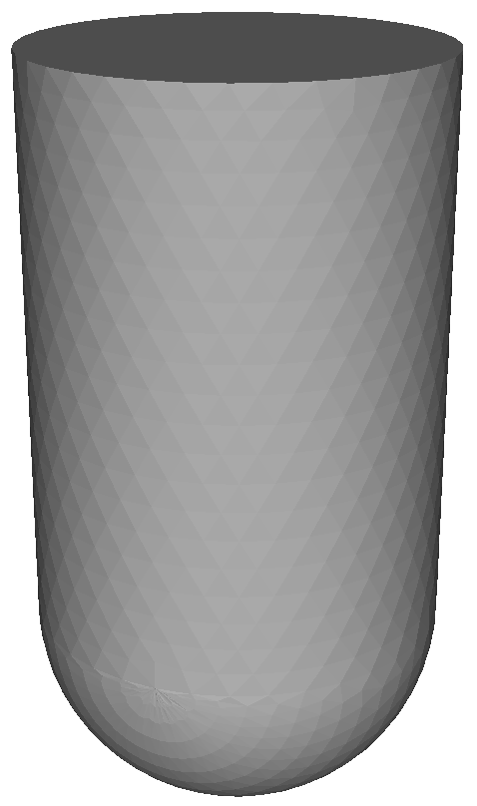
Subtractive manufacturing simulation

Slide 5




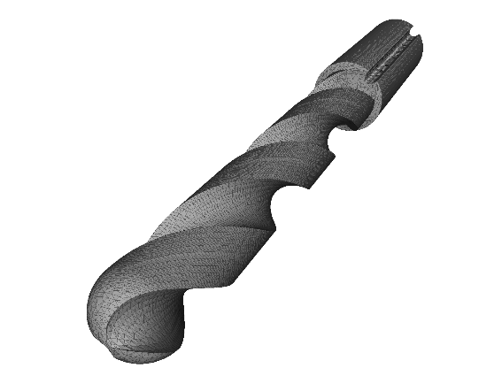
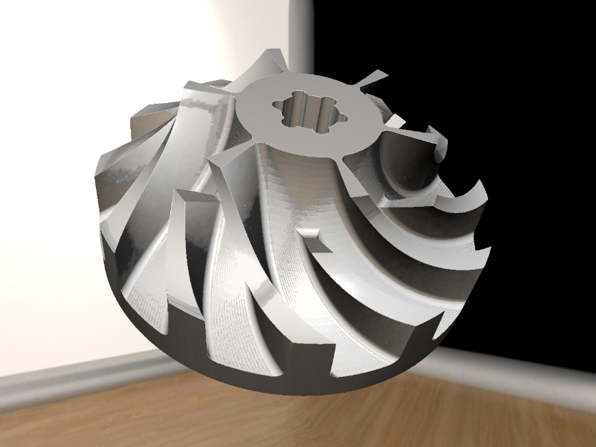
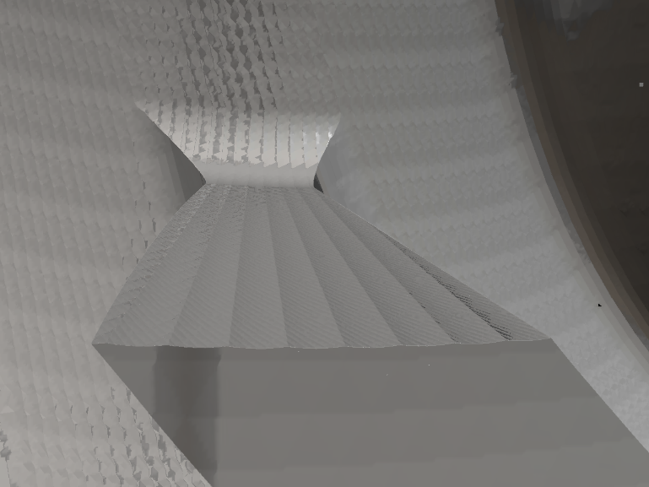
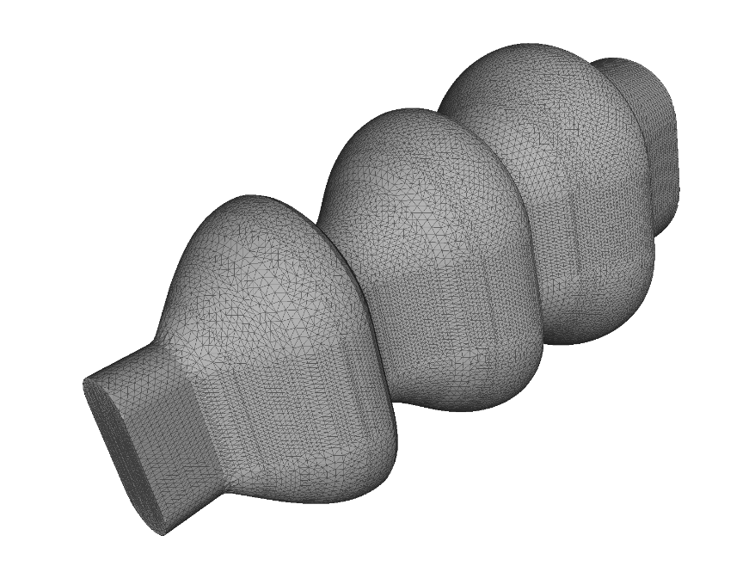
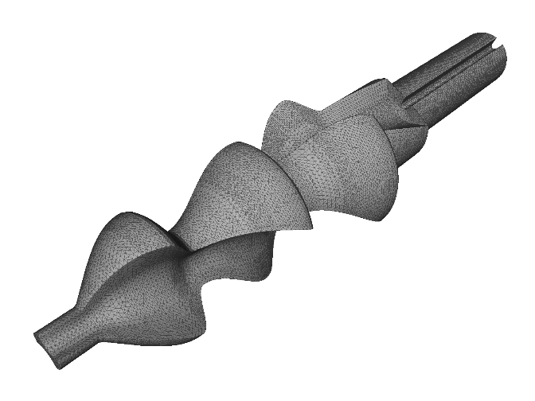
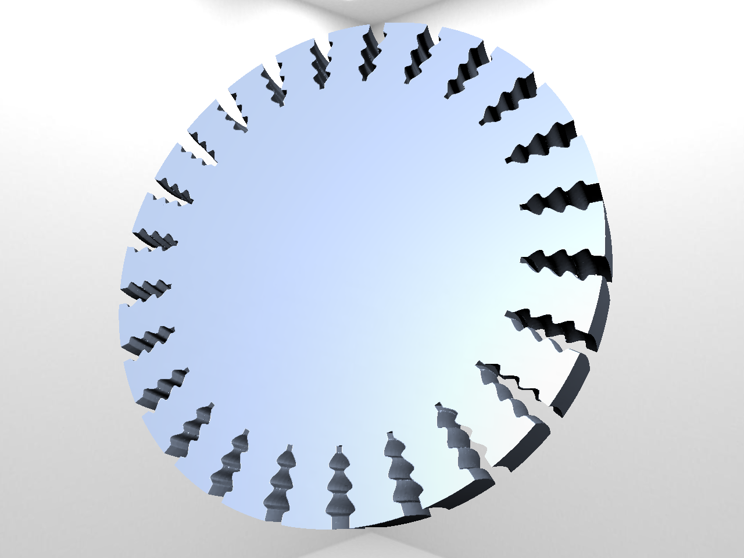
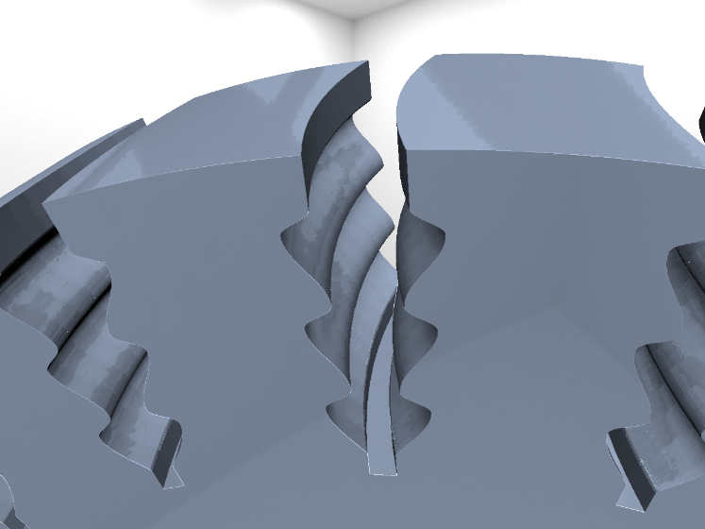
Previous work – VML
Notes:
Raycasting implemented

Slide 6
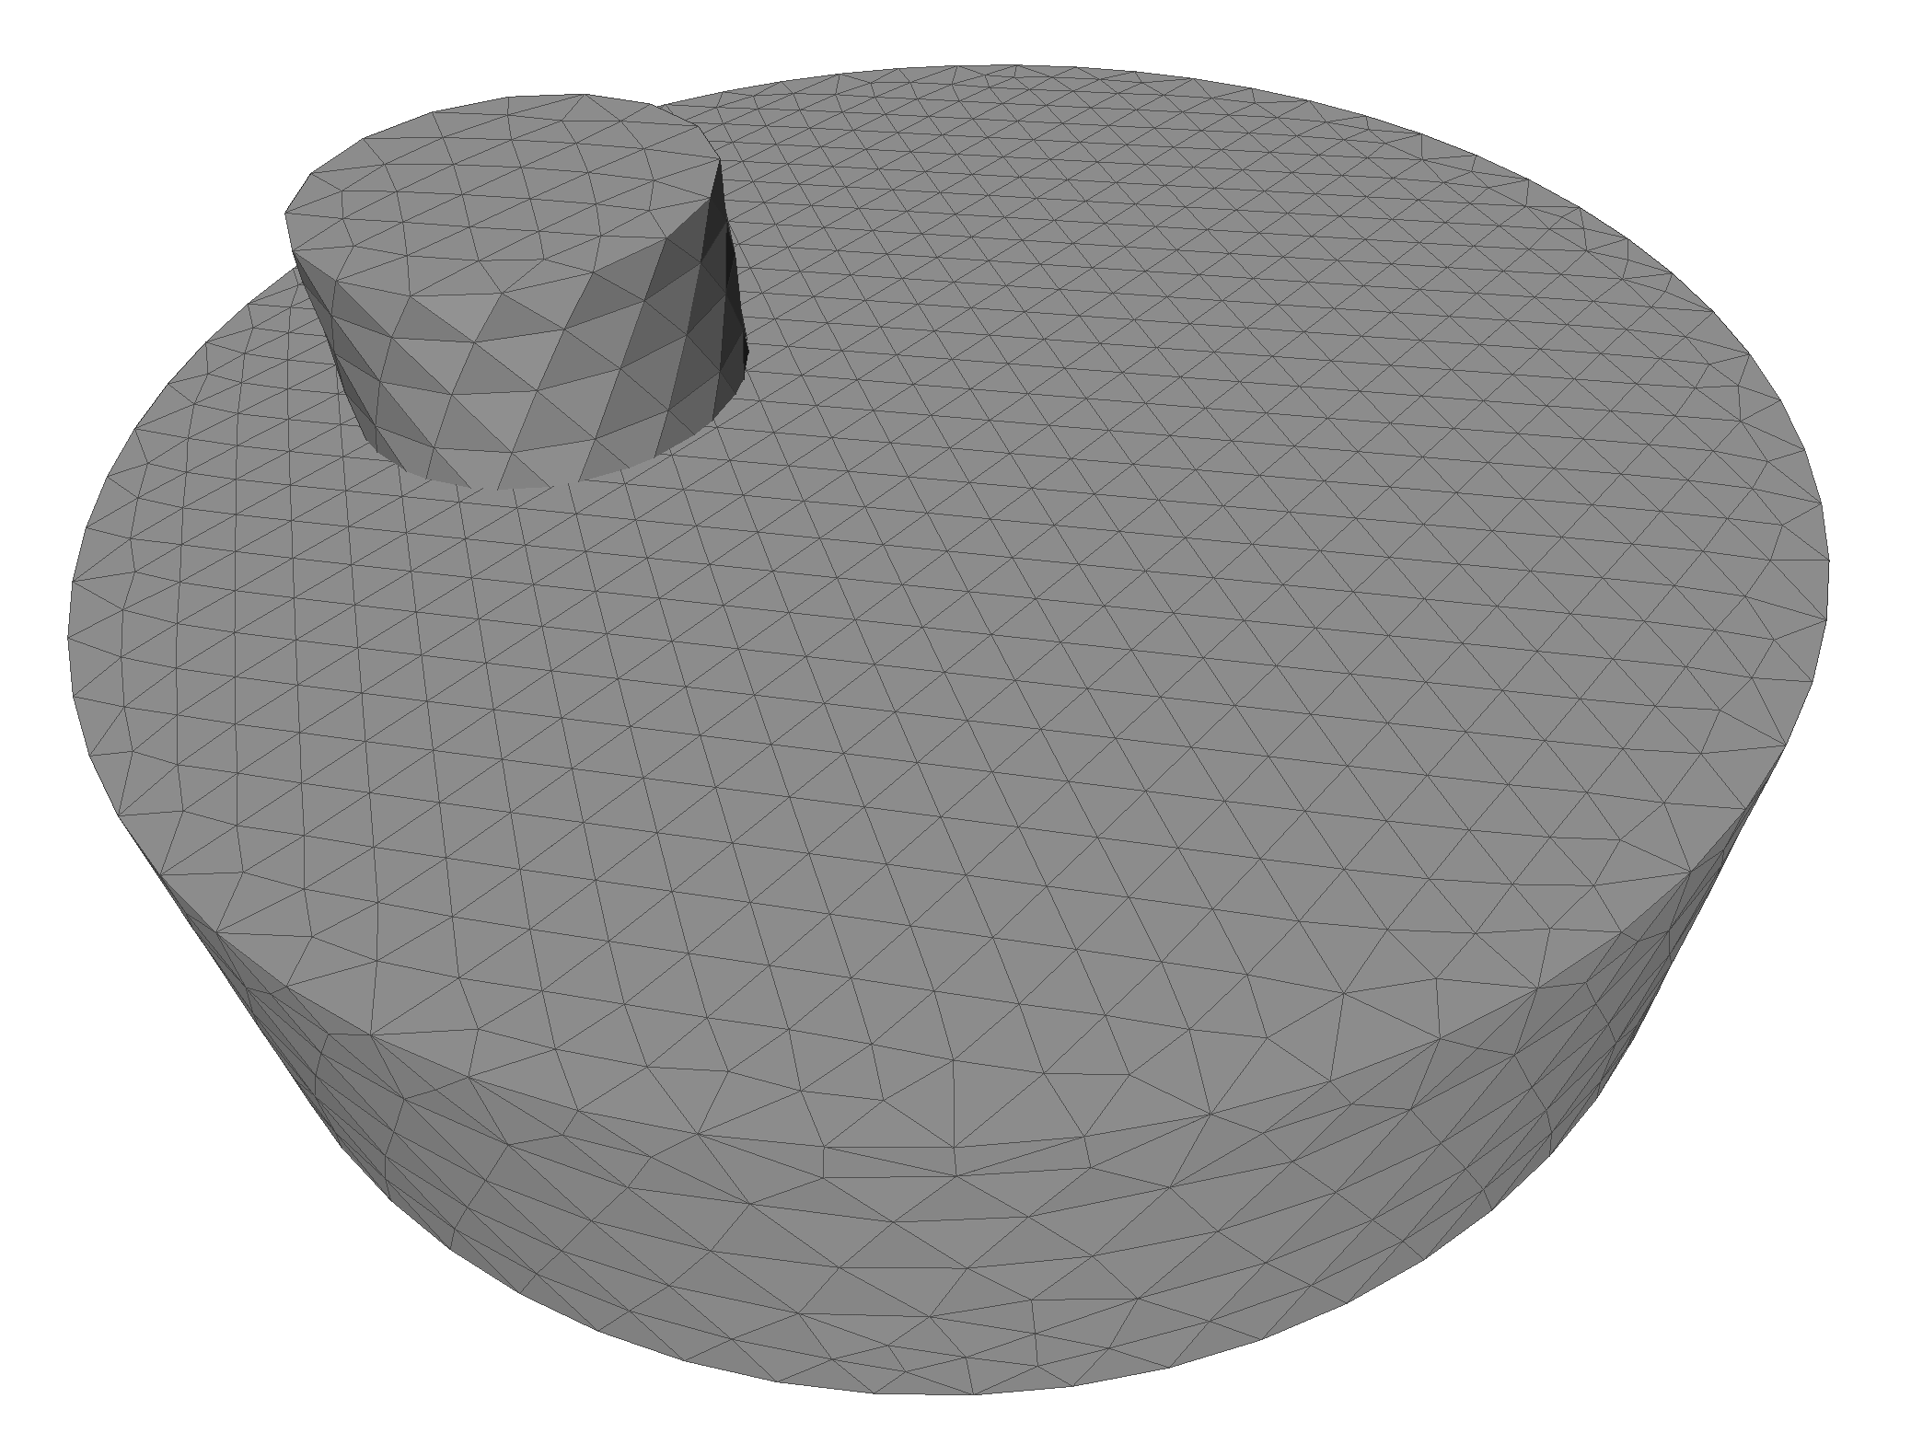
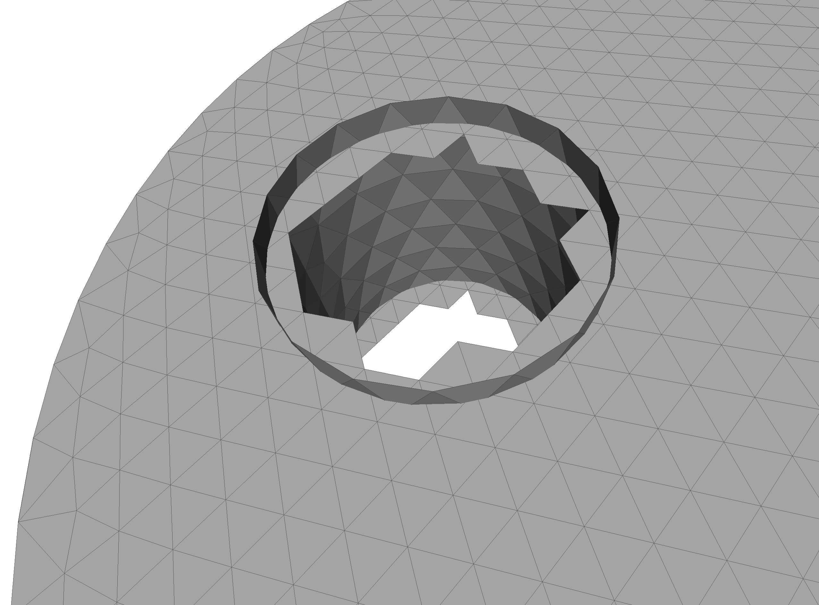
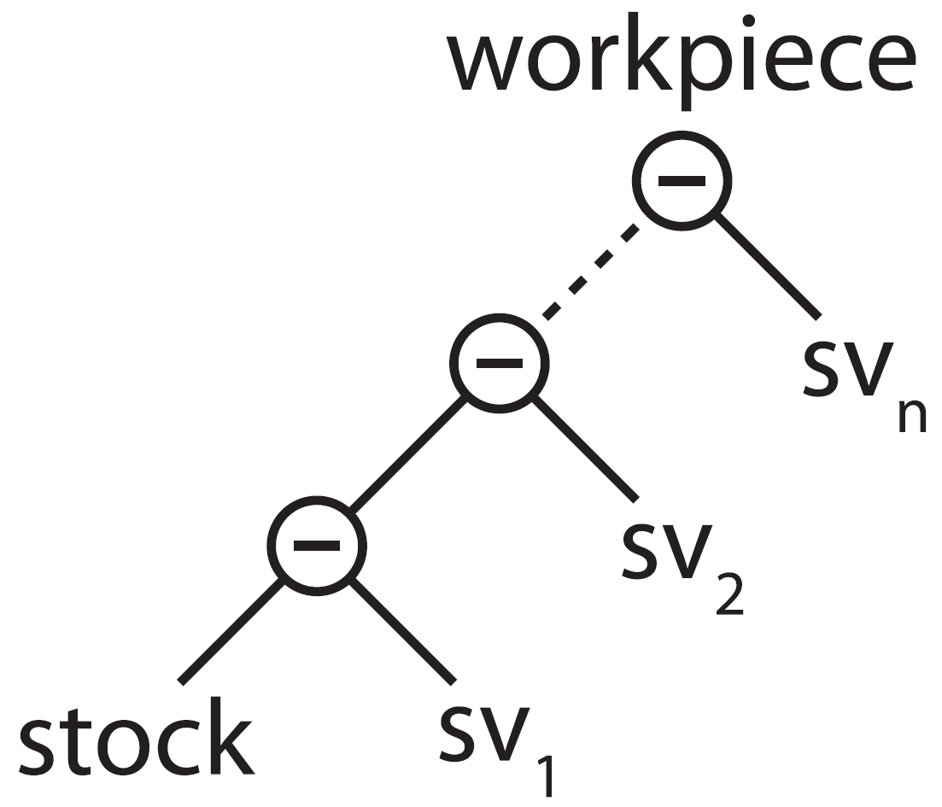
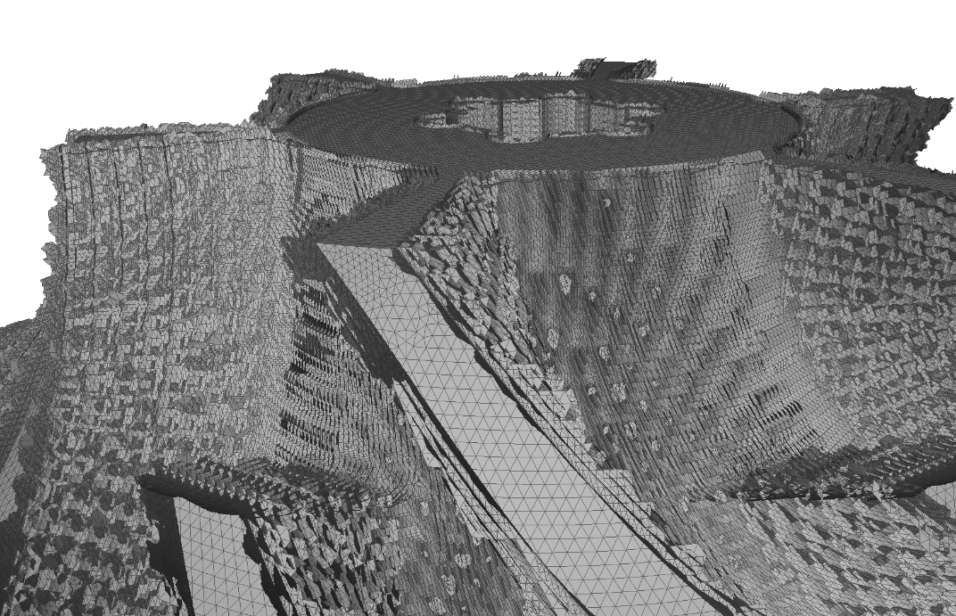
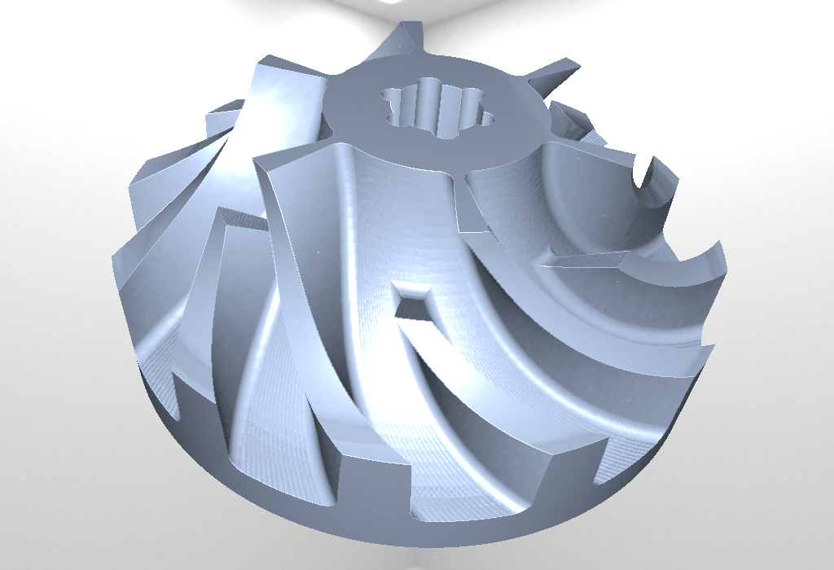
VML data model

Slide 7
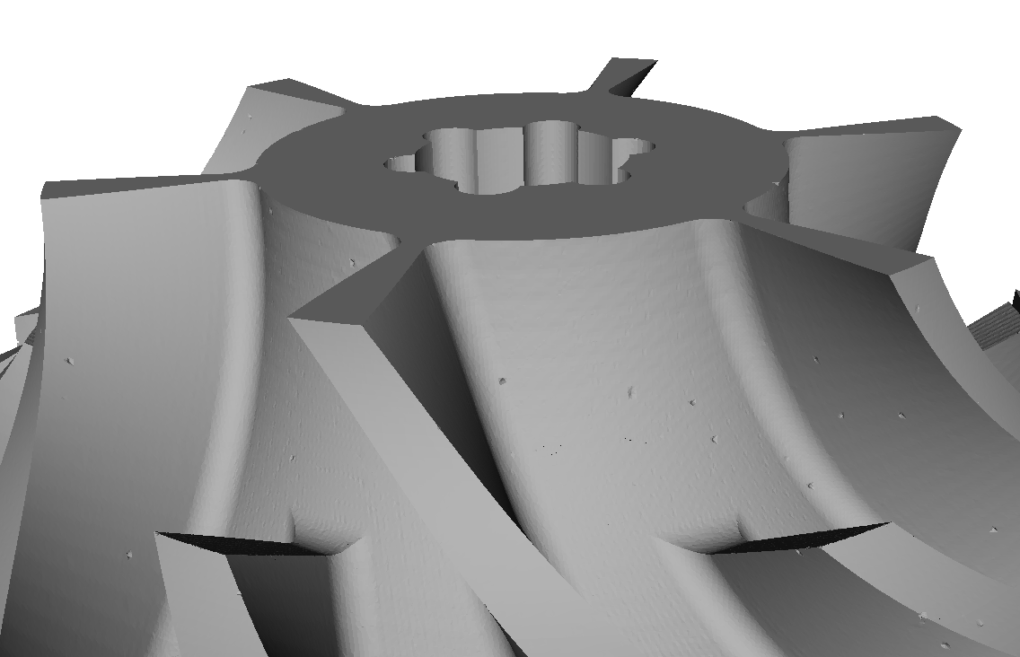
Problem statement
Extract triangulated surface from VML data model
Prototypic implementations
Testing on selected scenes
Comparison
Runtime, memory, complexity, errors, numeric stability, mesh quality, visual quality, feature conservation

Slide 8
Approaches
Direct intersection of swept volumes
Most naïve, theoretically most accurate
Tri-dexel
Dexel images easy to create using raycast
Reconstruction from tri-dexel grid
Point cloud based
Point cloud easy to create using raycast
Reconstruction using region-growing on points
Reconstruction using function fitting

Slide 9
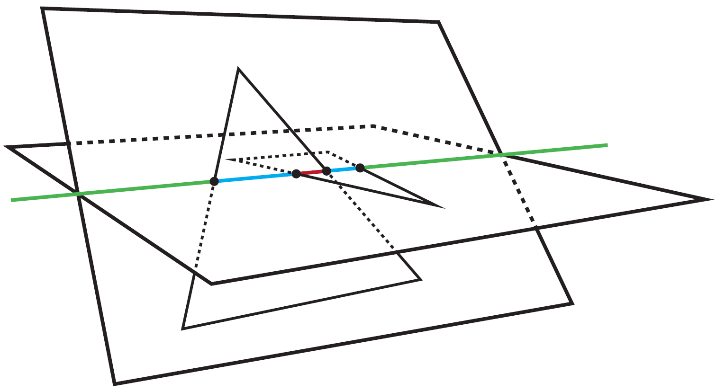
Direct intersection
Thomas Möller, A fast triangle-triangle intersection test, 1997
David Rosen, Seamless Intersection Between Triangle Meshes, 2008

Slide 10
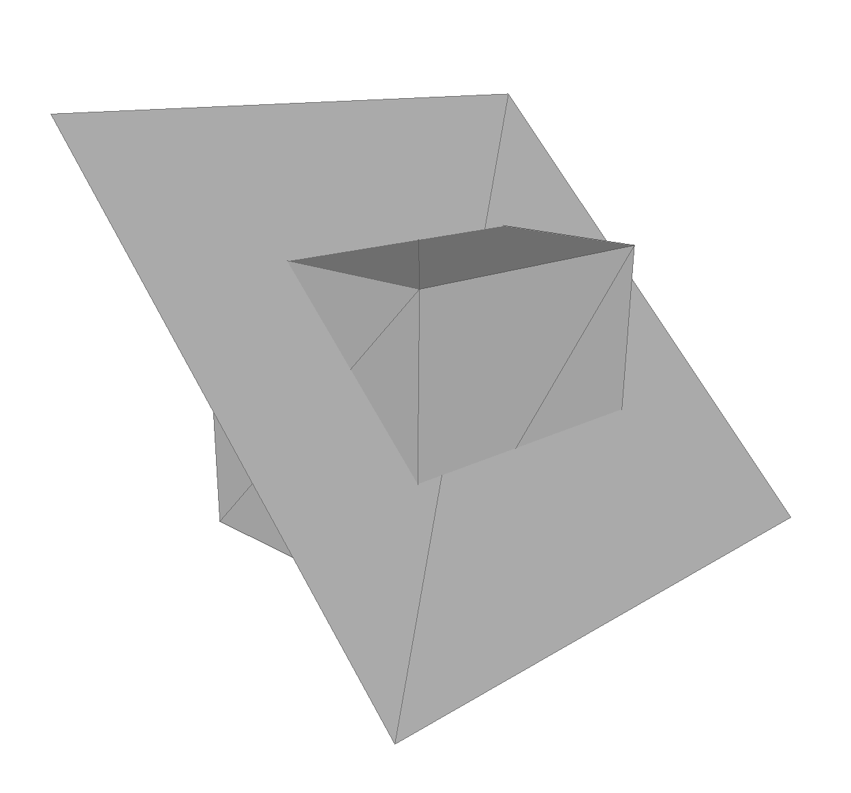
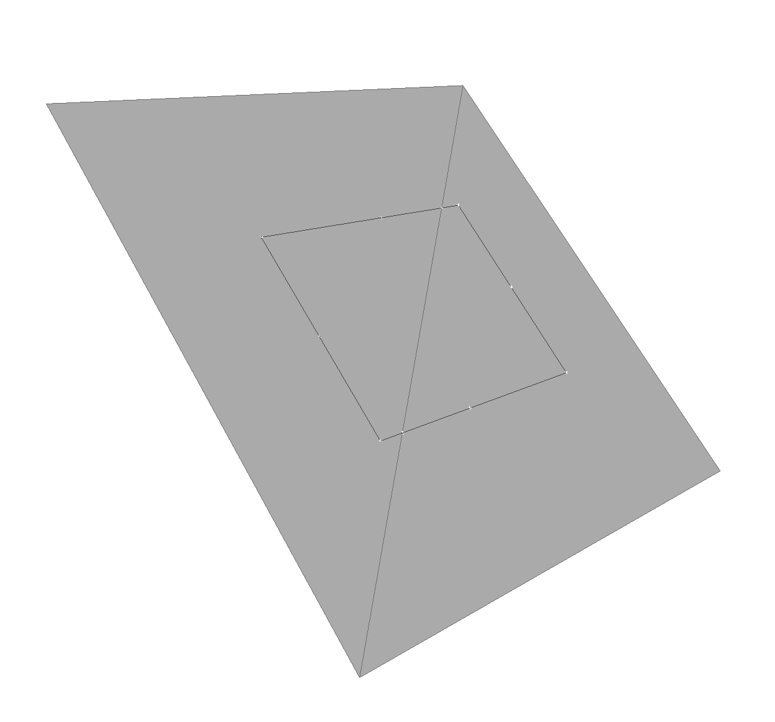
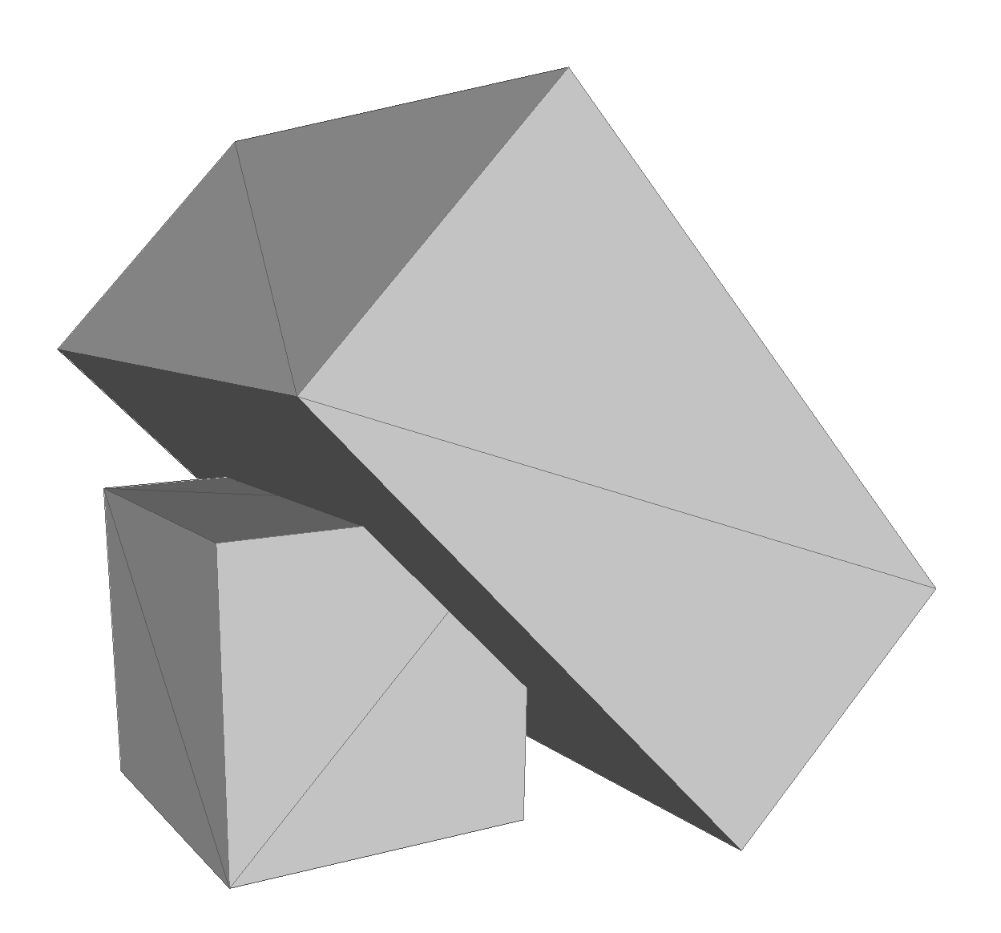
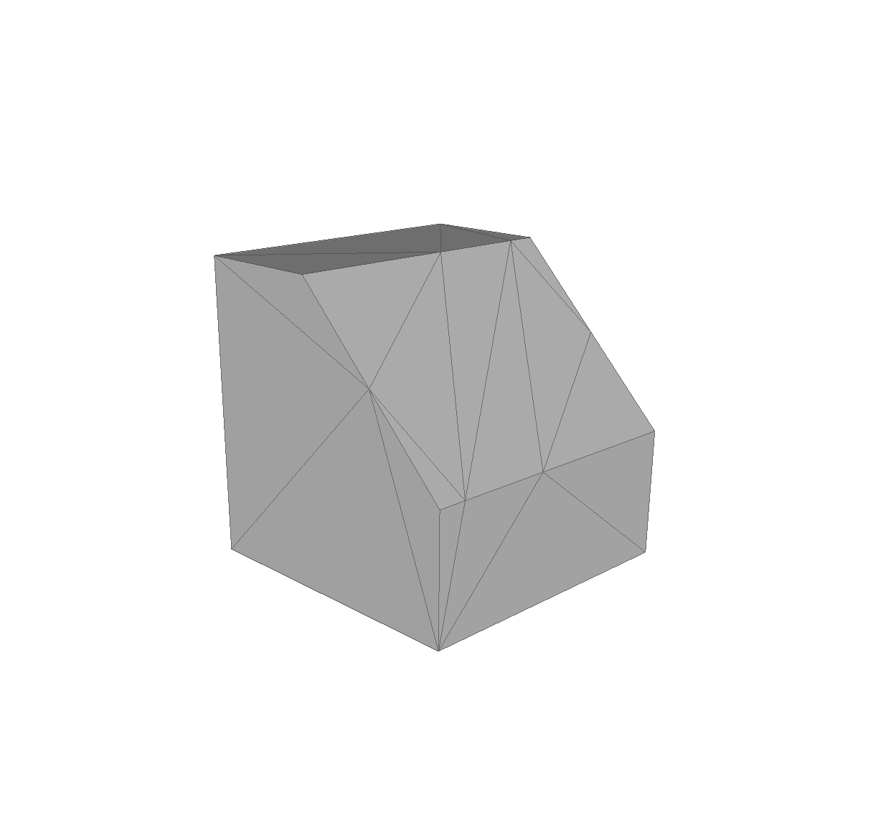

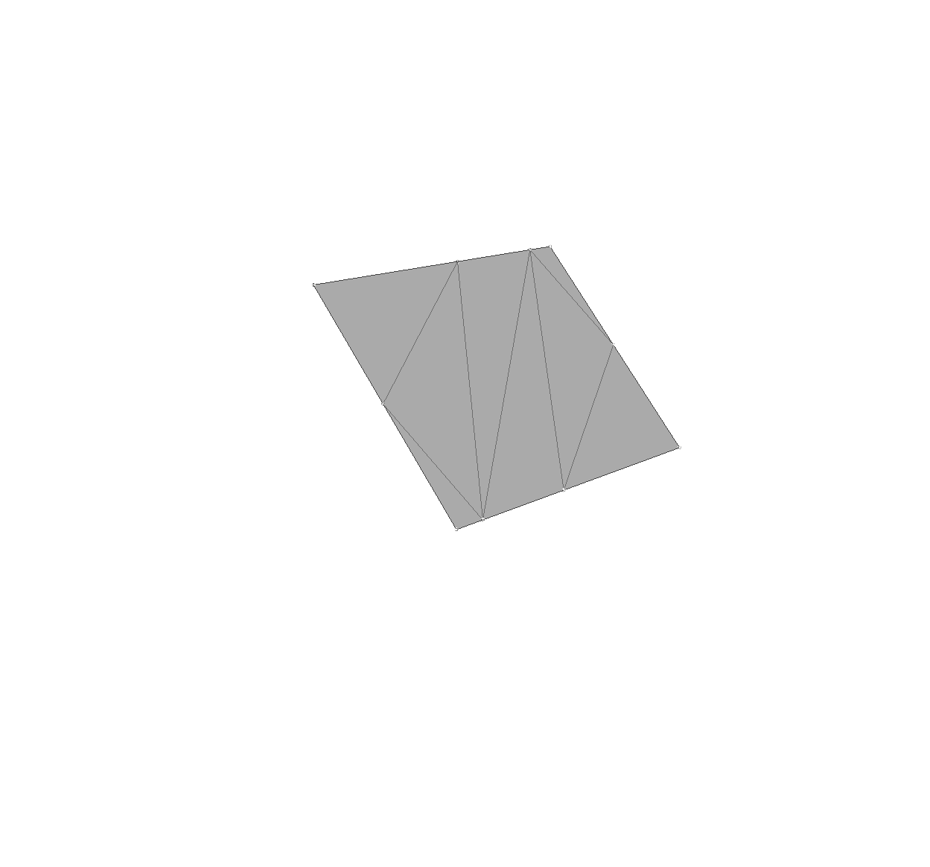
Direct intersection

Slide 11
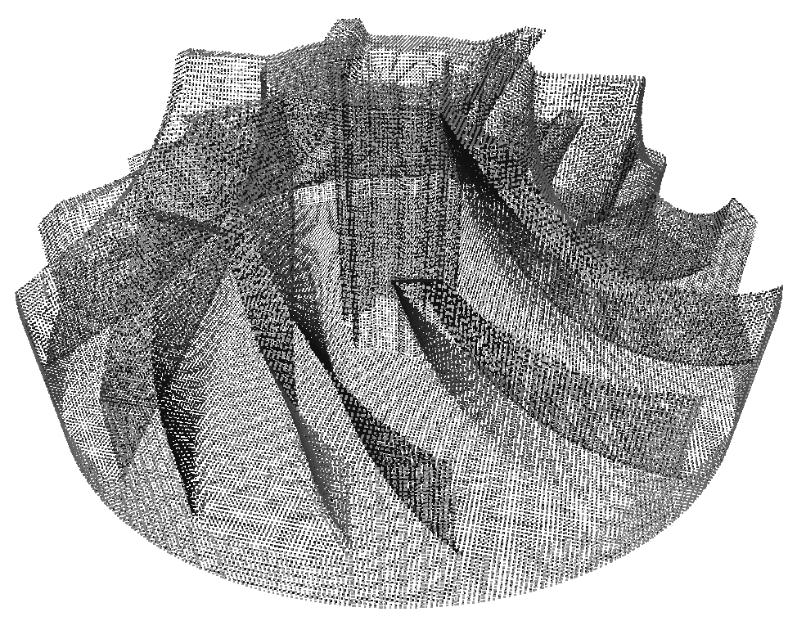
Point cloud based
3 axis-aligned raycasts to sample point cloud
same code as dexel image sampling

Slide 12
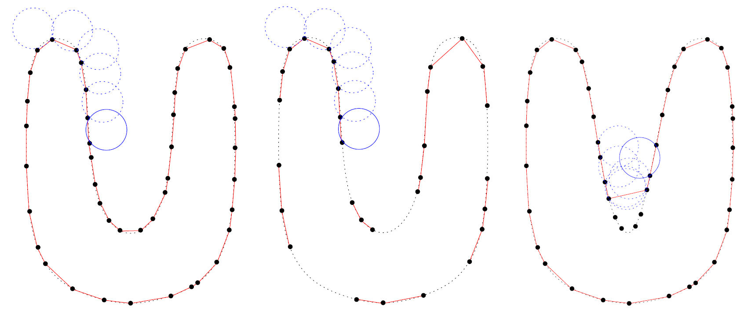
Ball pivoting algorithm (BPA)
Fausto Bernardini et.al., The ball-pivoting algorithm for surface reconstruction, 1999

Slide 13
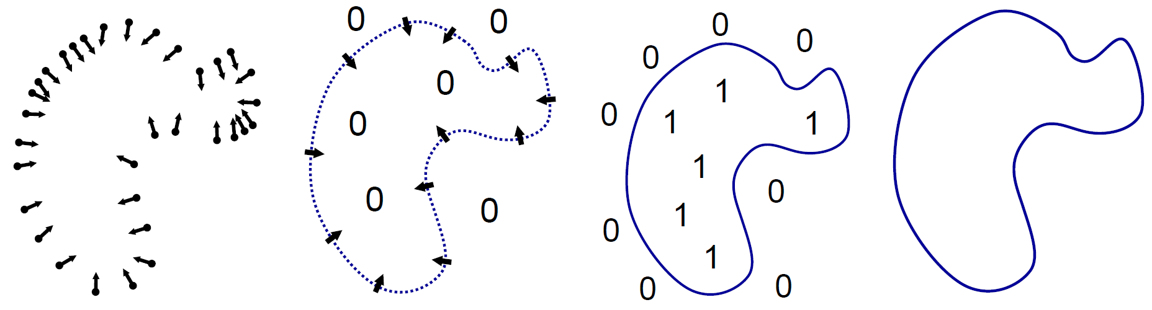
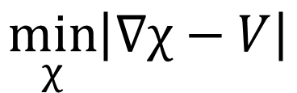
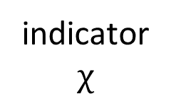
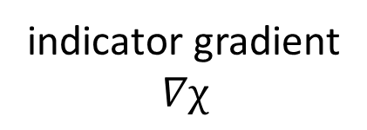
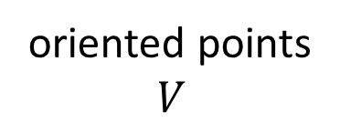
Poisson
oriented points $$V$$
indicator gradient $$∇χ$$
indicator $$χ$$
isosurface
$$\min_{χ}\left|∇χ−V\right|$$
Michael Kazhdan etal., Poisson Surface Reconstruction, 2006

Slide 14
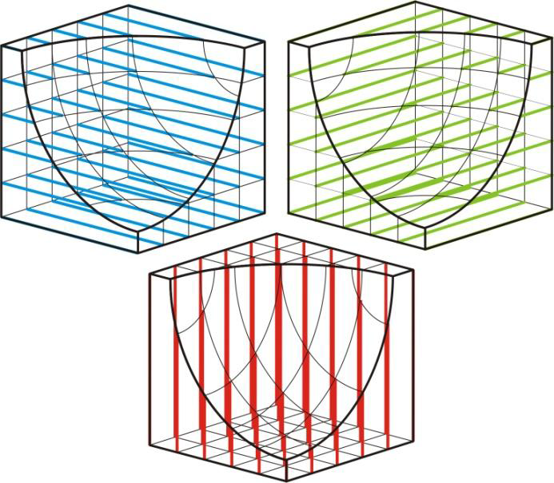
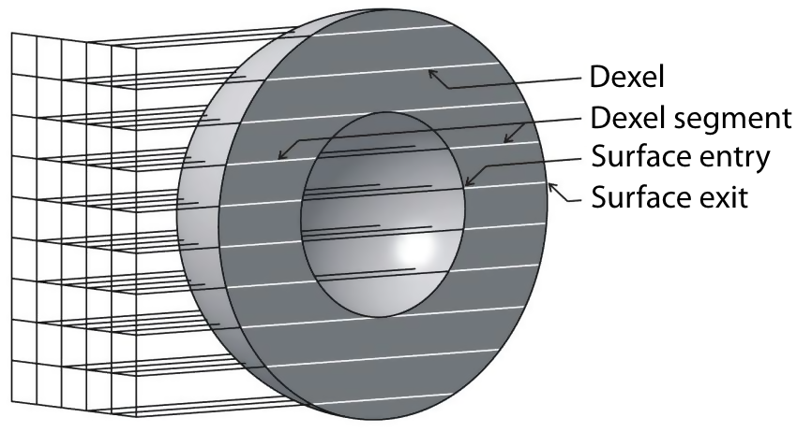
Tri-dexel

Slide 15
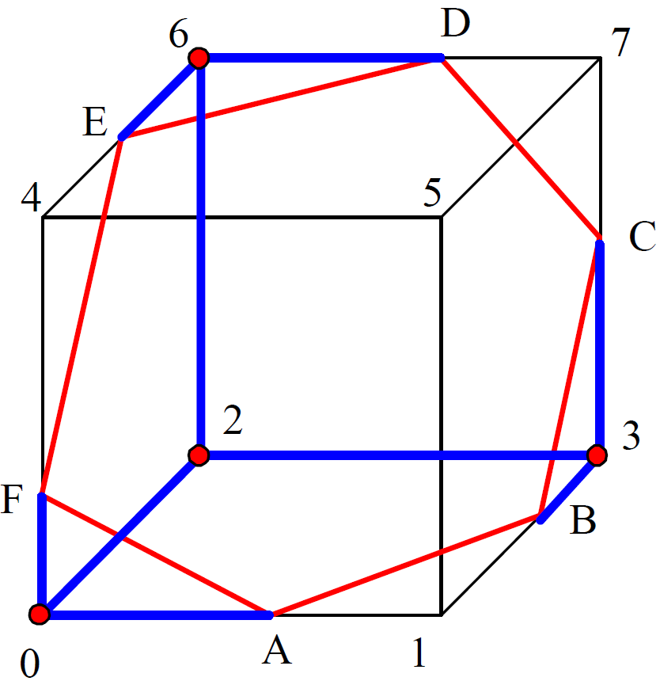
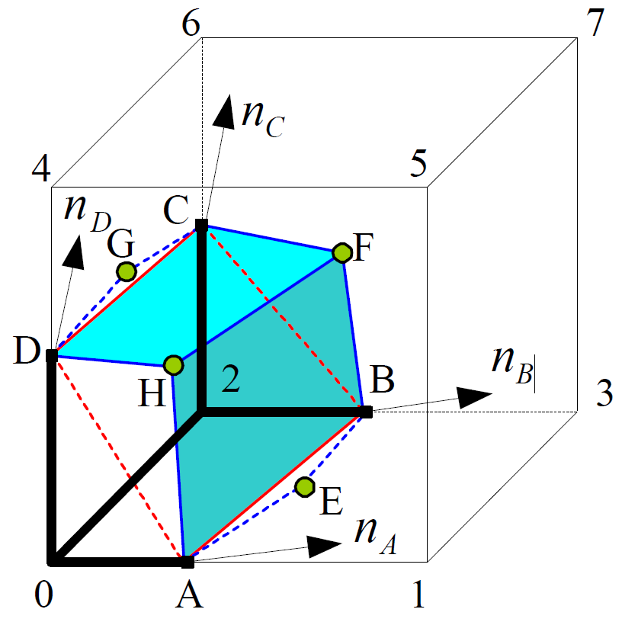
Tri-dexel
Yongfu Ren et al., Feature conservation and conversion of Tri-dexel volumetric models to polyhedral surface models for product prototyping, 2008

Slide 16
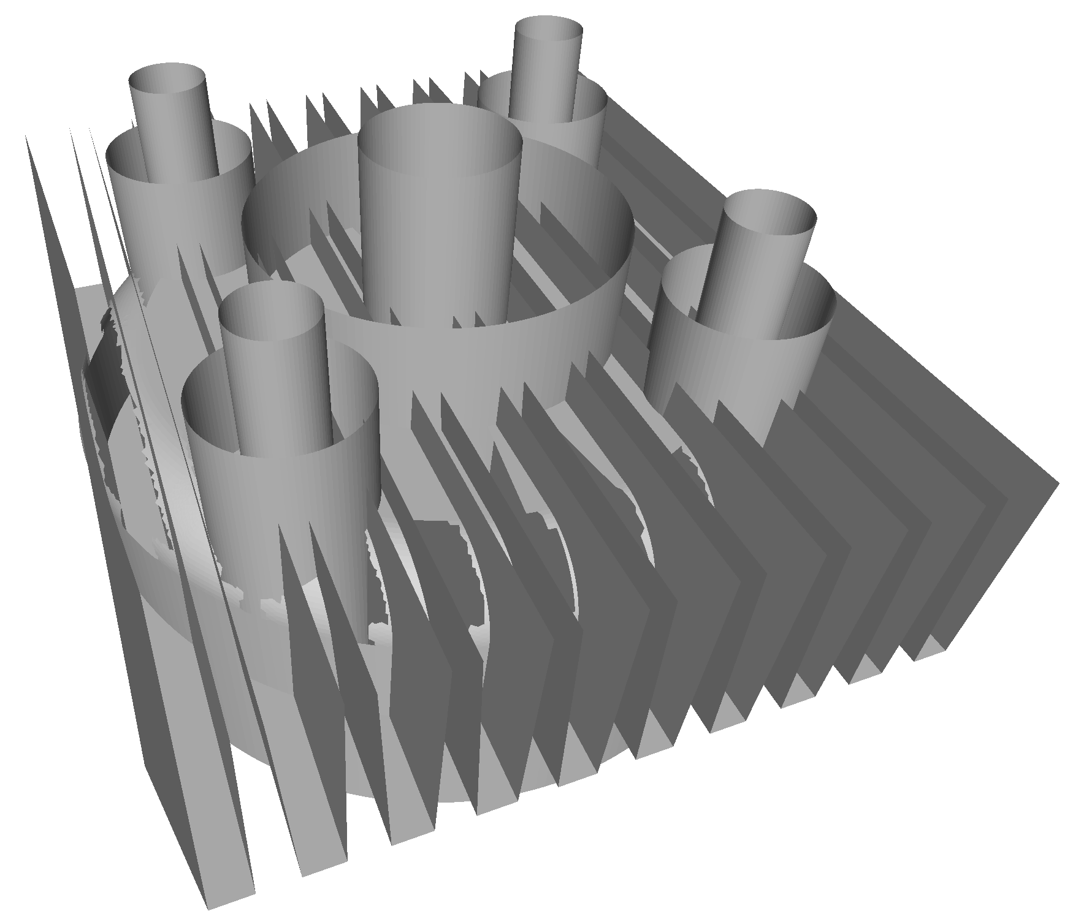
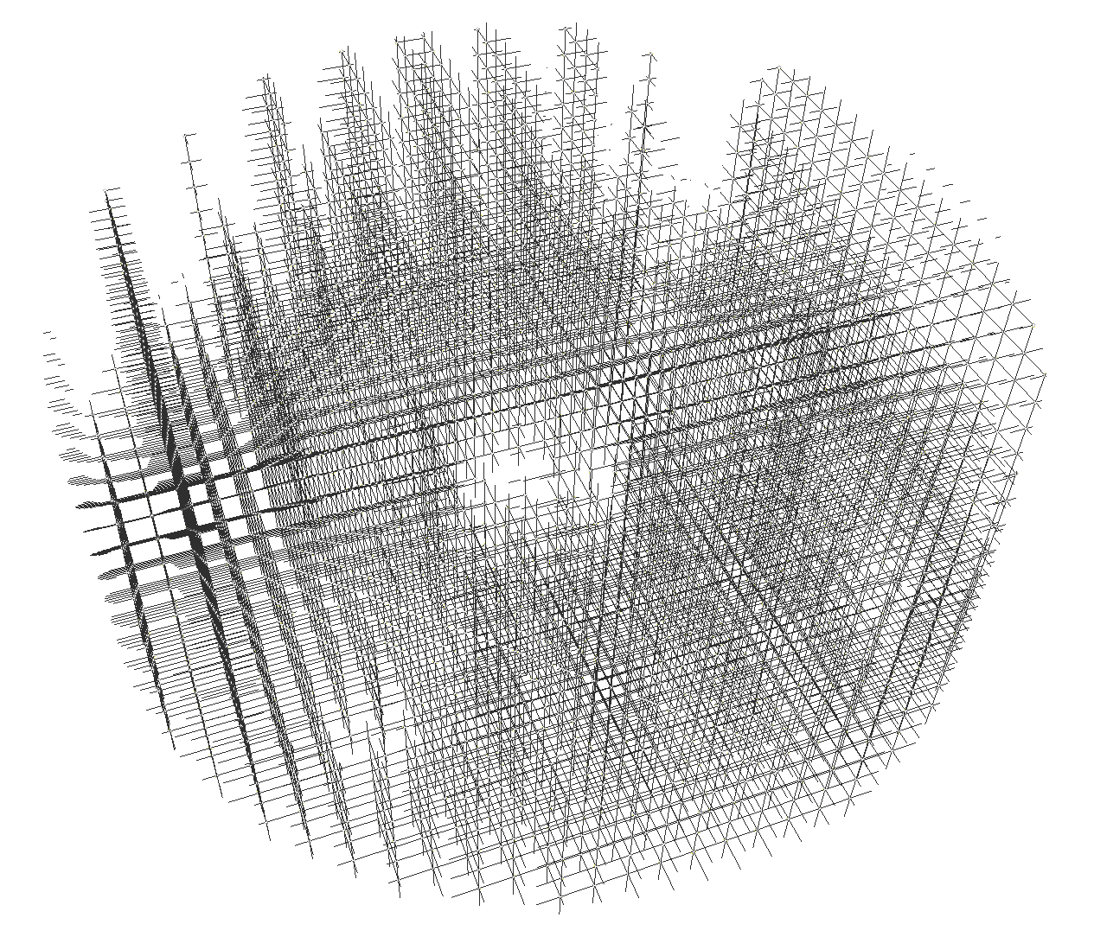
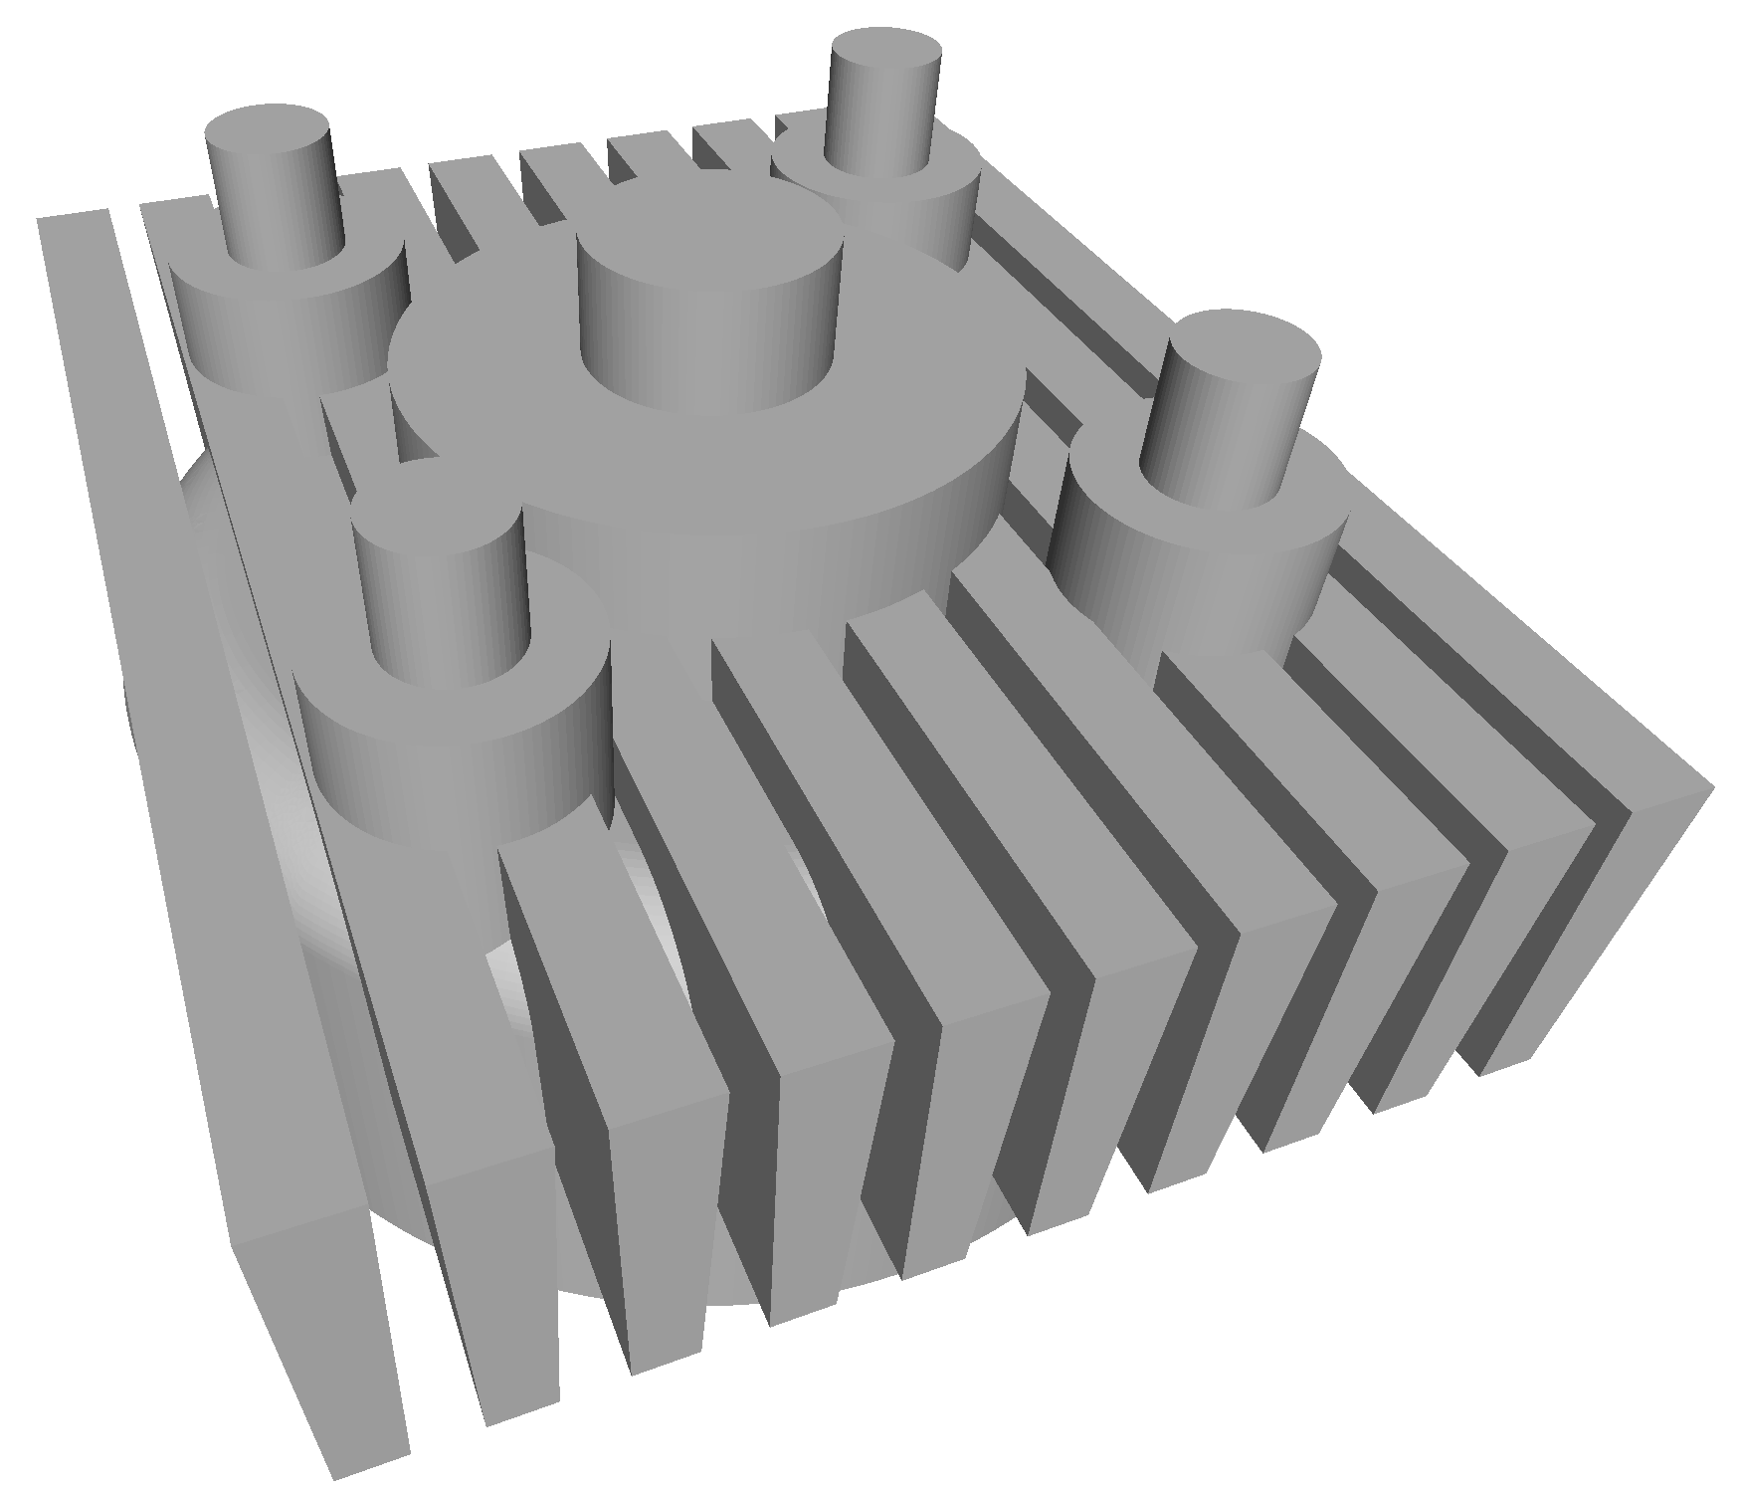
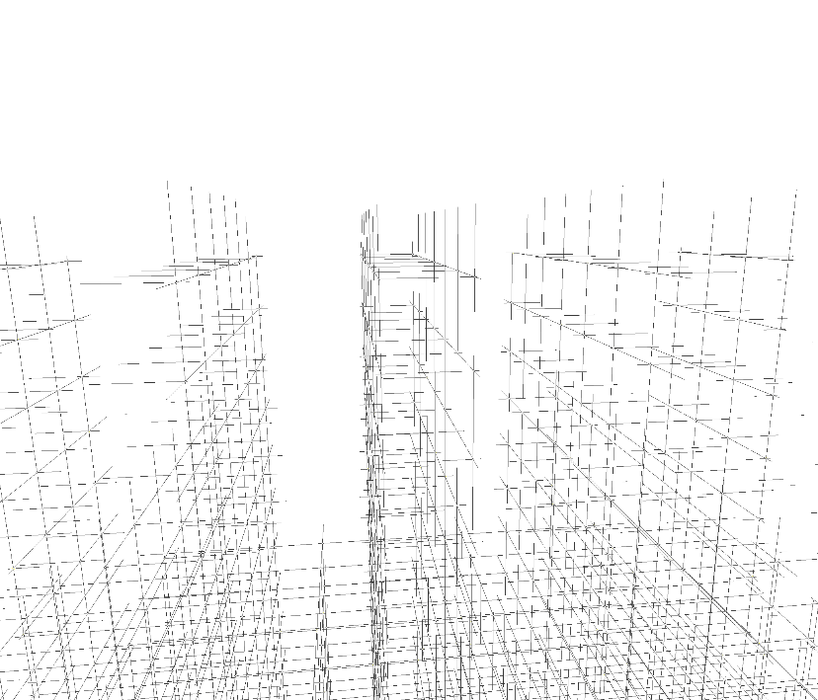
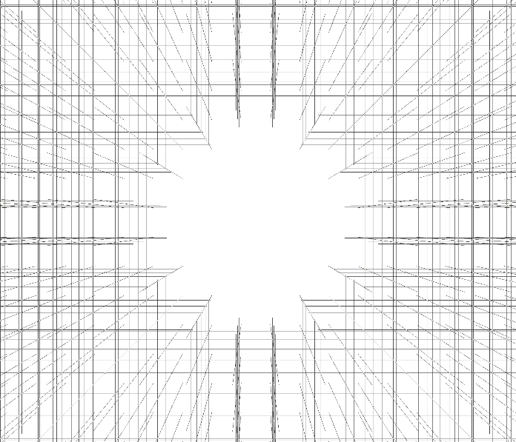
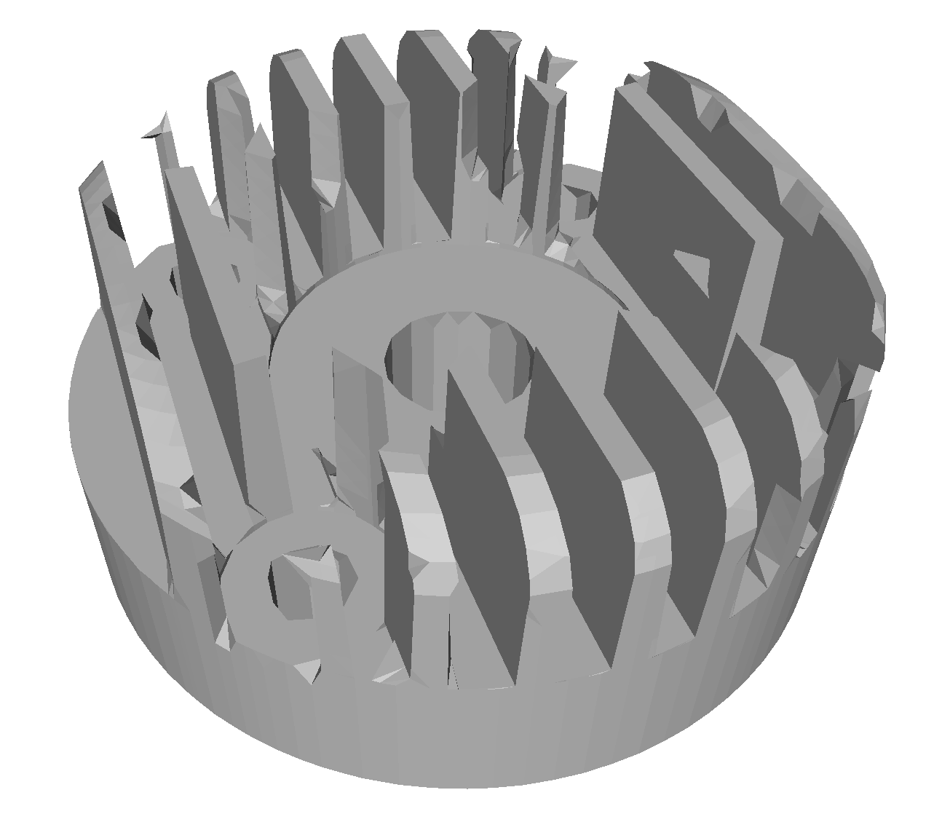
Tri-dexel

Slide 17
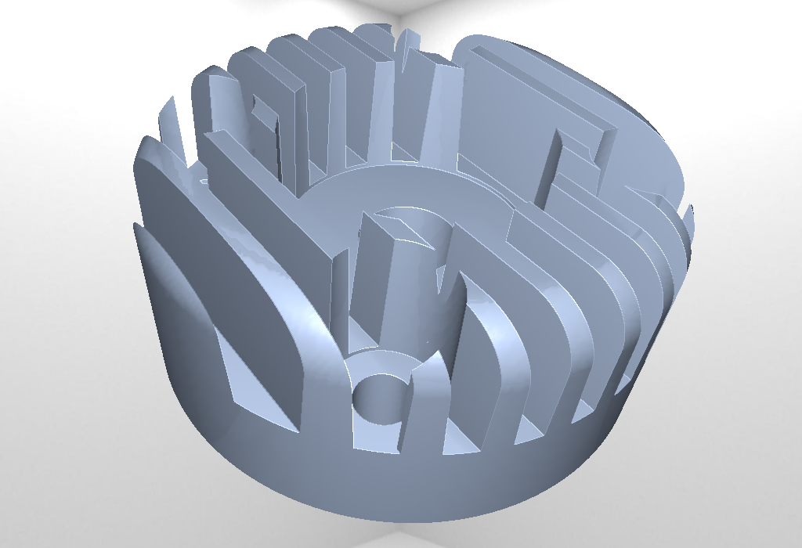
Test scenes
cylinder_head
impeller

Slide 18
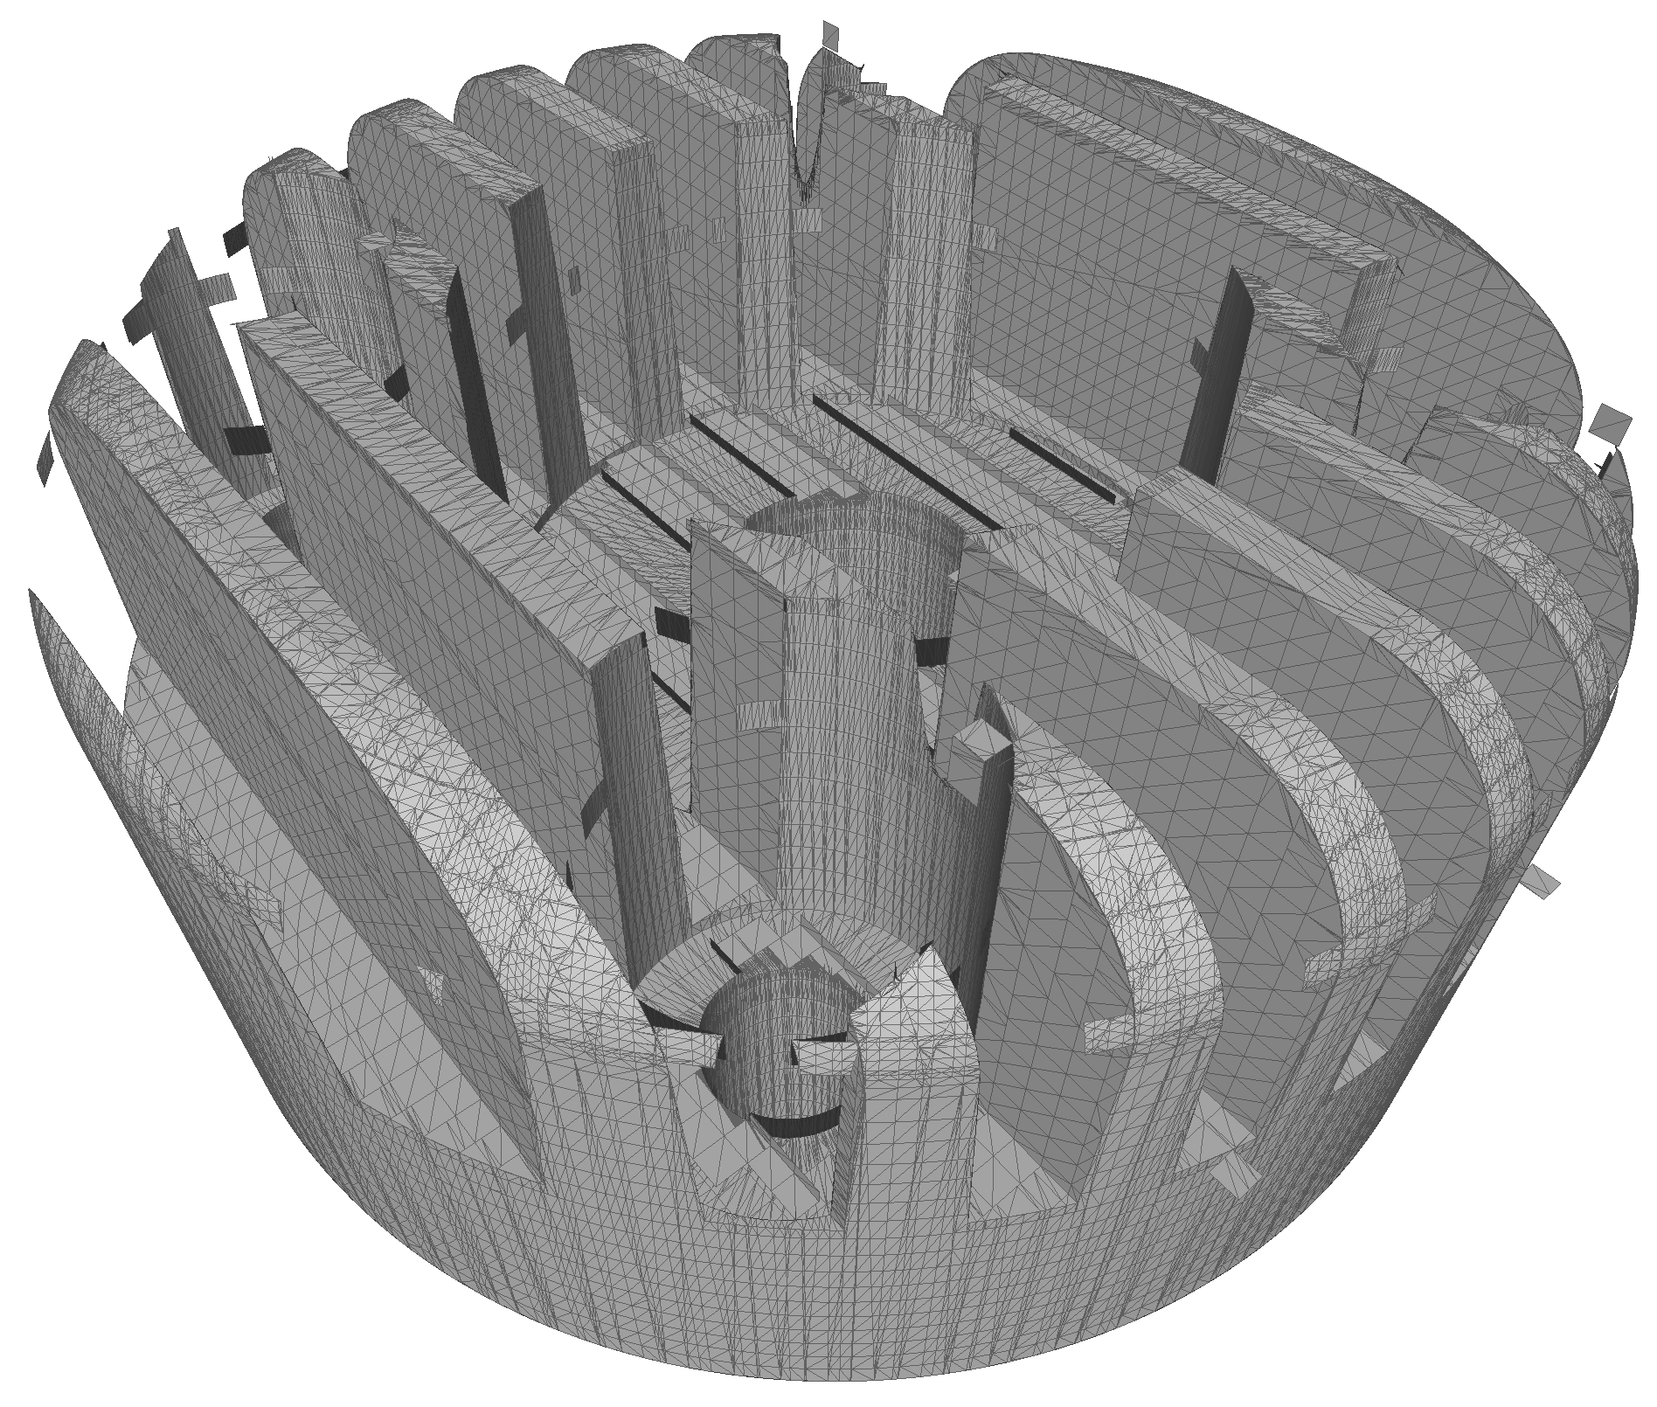
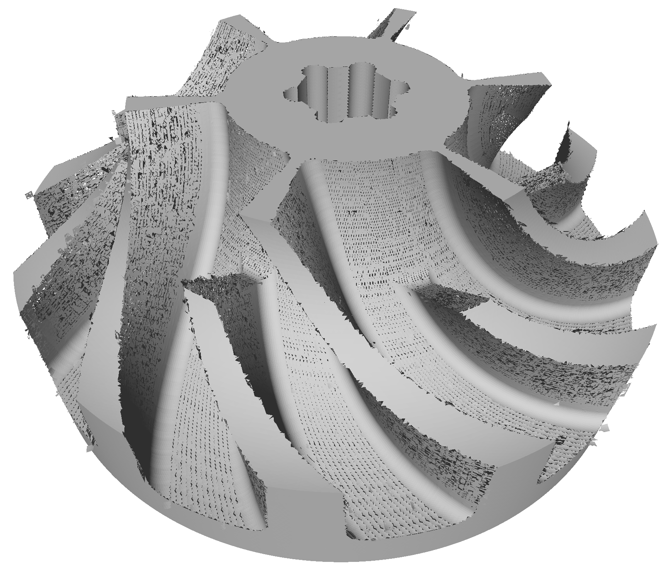
Results – Direct intersection
229ms, 149k
21s, 1.7M

Slide 19
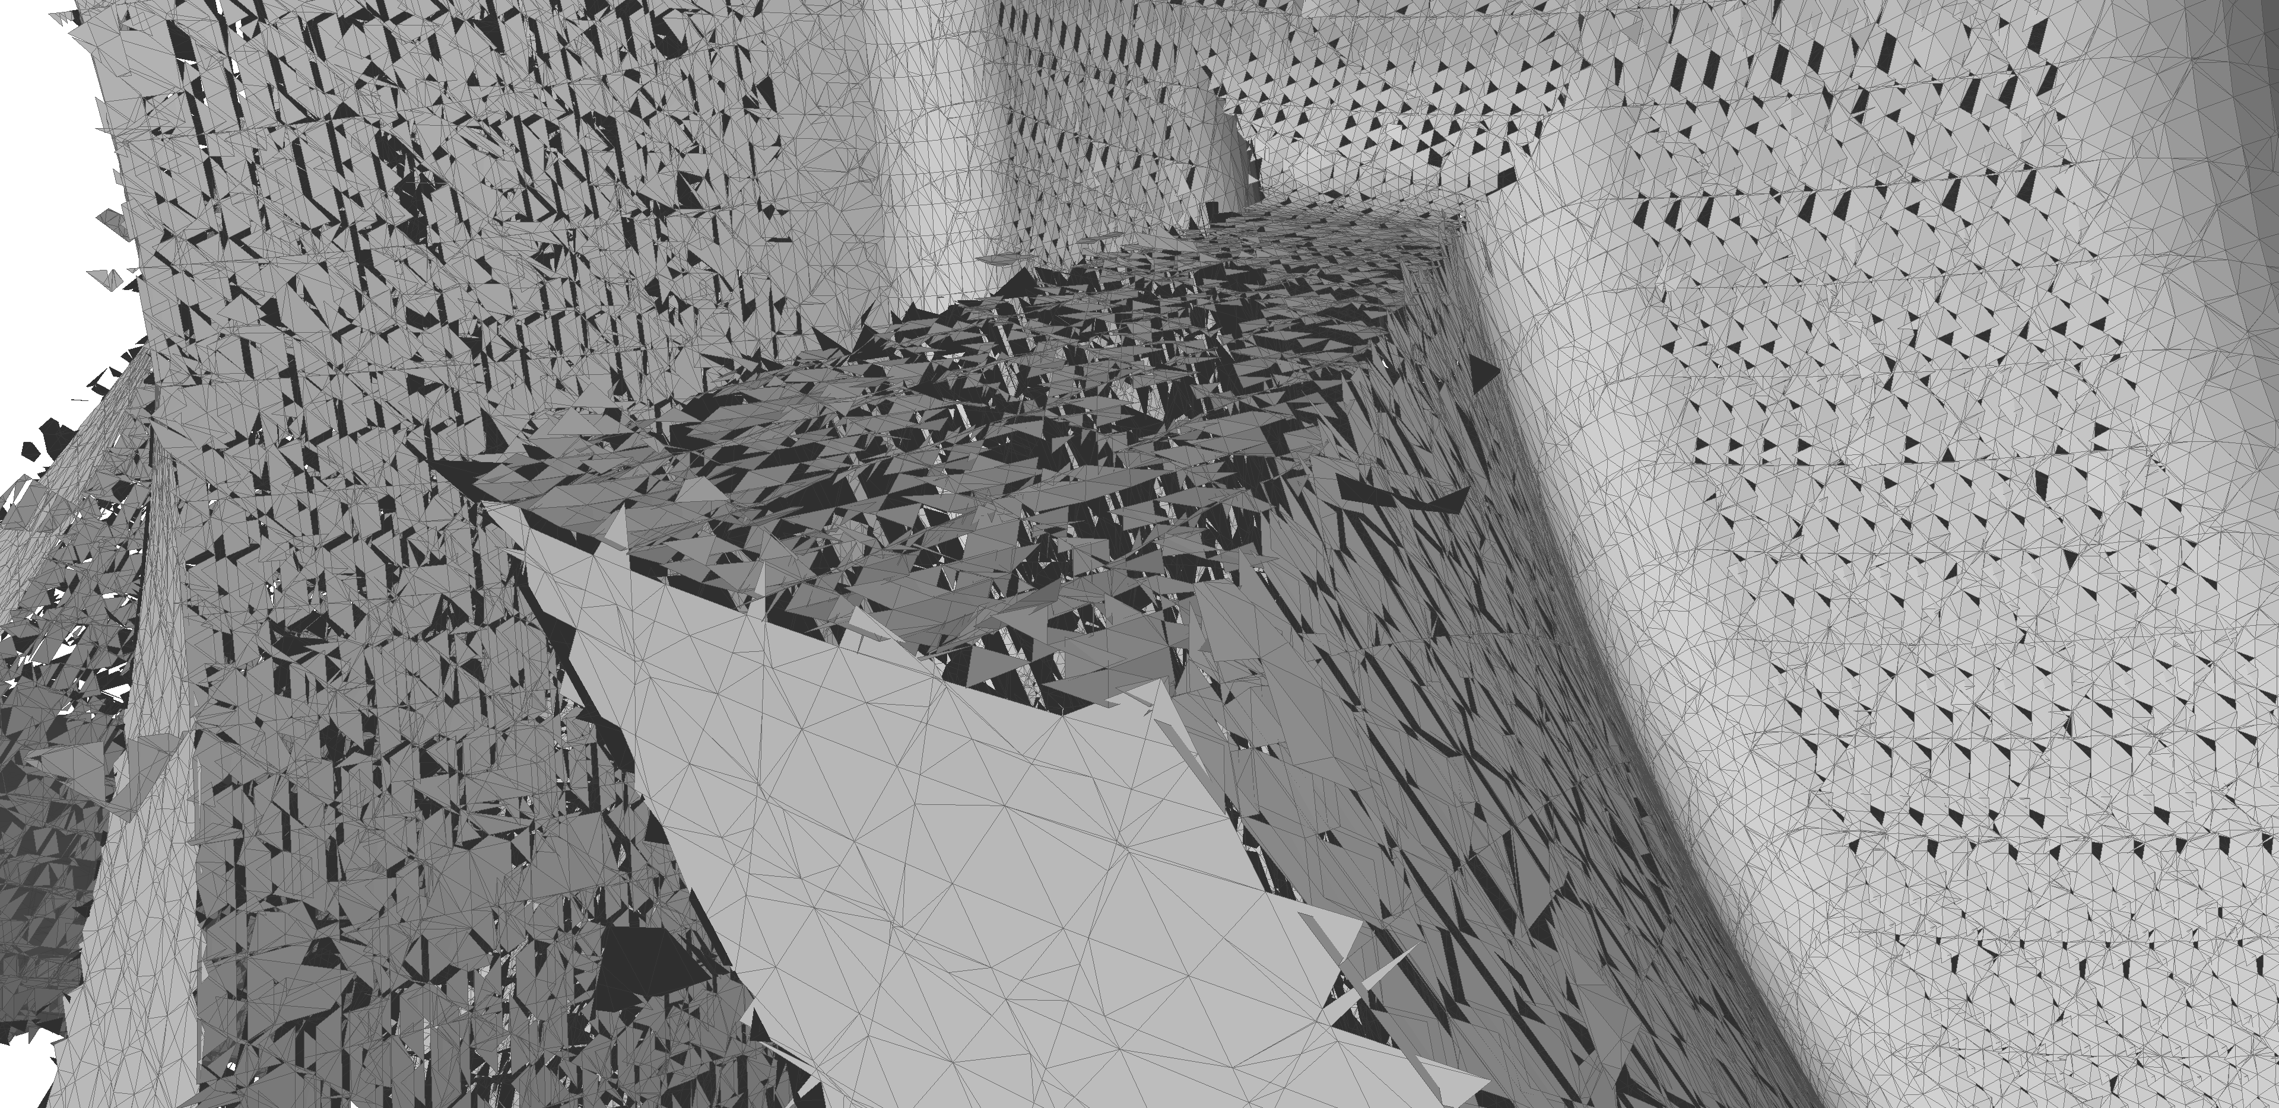
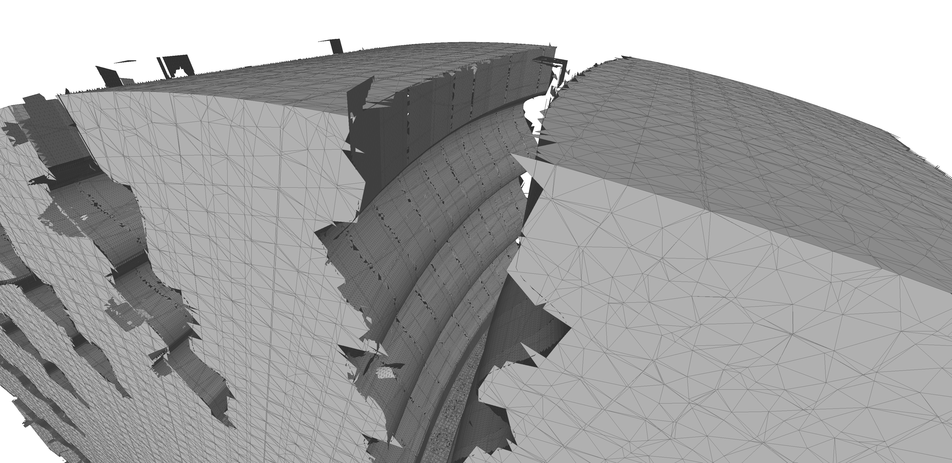
Results – Direct intersection

Slide 20
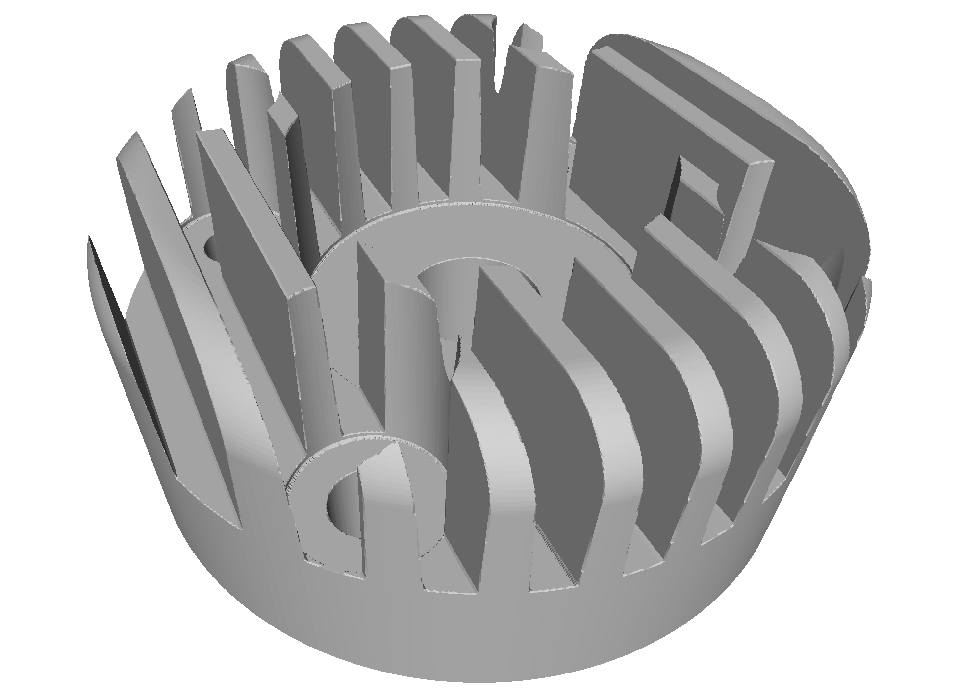
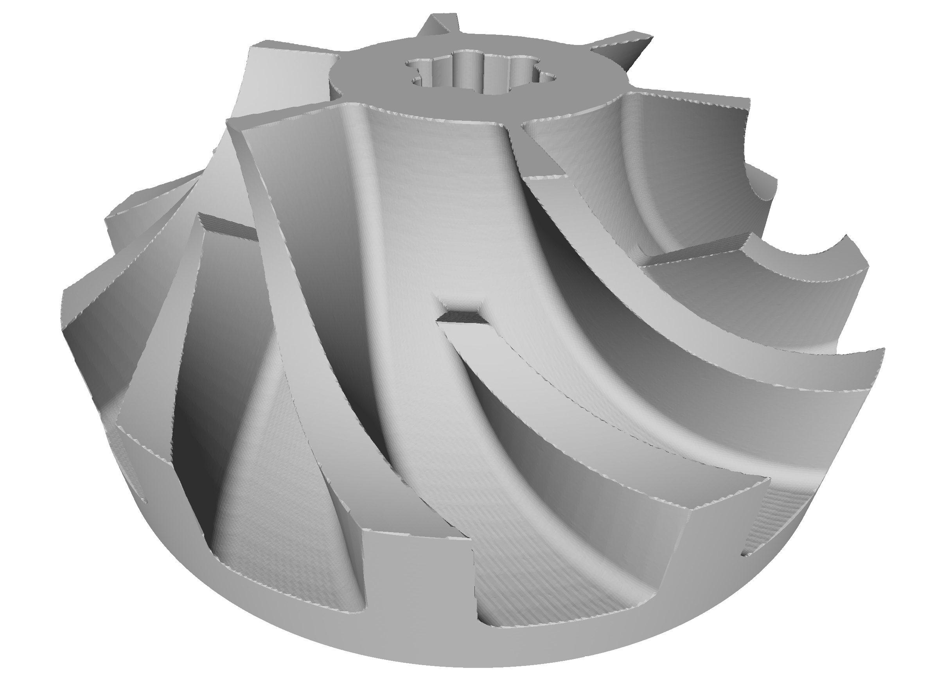
Results – BPA
4.3s, 1.9M
3.7s, 1.5M

Slide 21
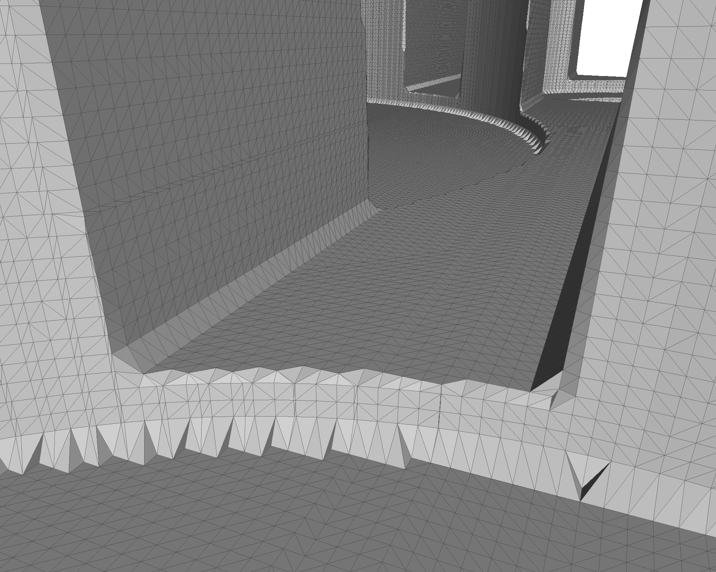
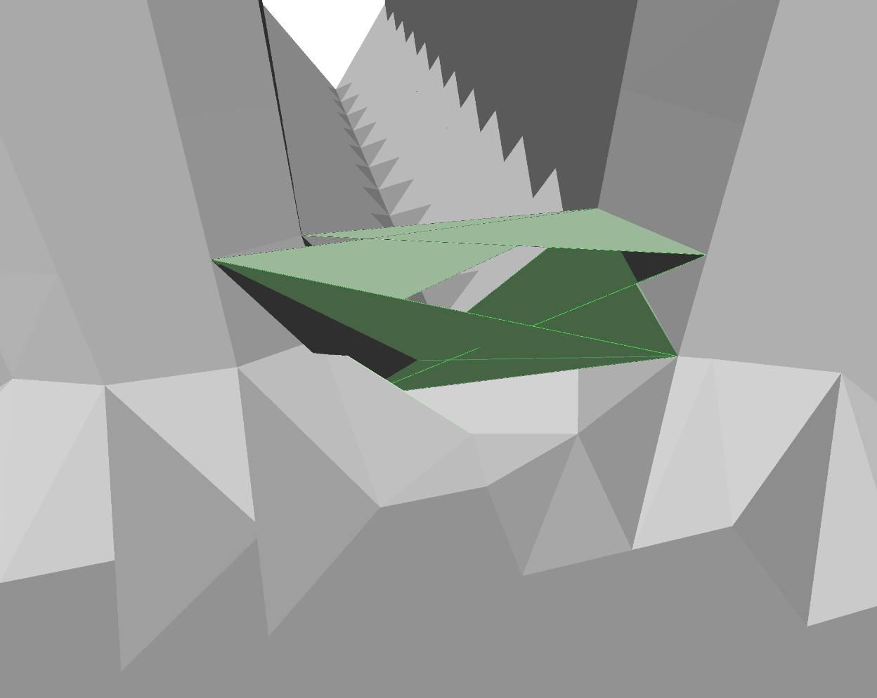
Results – BPA

Slide 22


Results – Poisson

Slide 23


Results – Poisson

Slide 24


Results – Tri-dexel
32s, 3.8M
27s, 3.0M

Slide 25


Results – Tri-dexel

Slide 26
Conclusion
Direct intersection
fails due to numeric issues
Ball pivoting algorithm
looses concave features
does not use normals
may create holes or role inside
Poisson
Fitting to imprecise in feature-rich regions
Tri-dexel
feature reconstruction using normals
feature detection and adaptive resampling (cell slicing)
simple parallelization

Slide 28
Additional slides

Slide 29




Resolutions – BPA
50
100
200
400

Slide 30




Resolutions – Poisson
50
100
200
400

Slide 31




Resolutions – Tri-dexel
50
100
200
400

Slide 32



Tri-dexel feature reconstruction

